Slide 1
Class 16 – Secondary Storage Management
Osama Hosam Eldeen
Taiba University

Slide 2
Disks

Slide 3

Disk geometry
Disk head, surfaces, tracks, sectors …

Slide 4
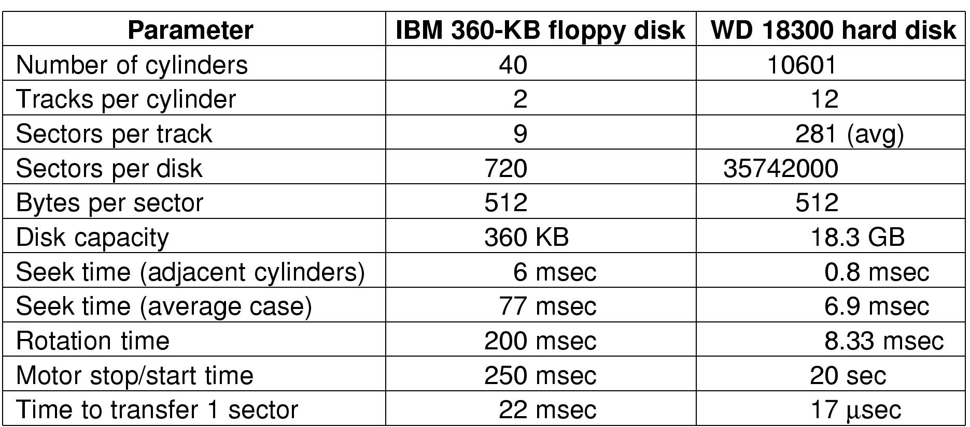
Comparison of (old) disk technology

Slide 5
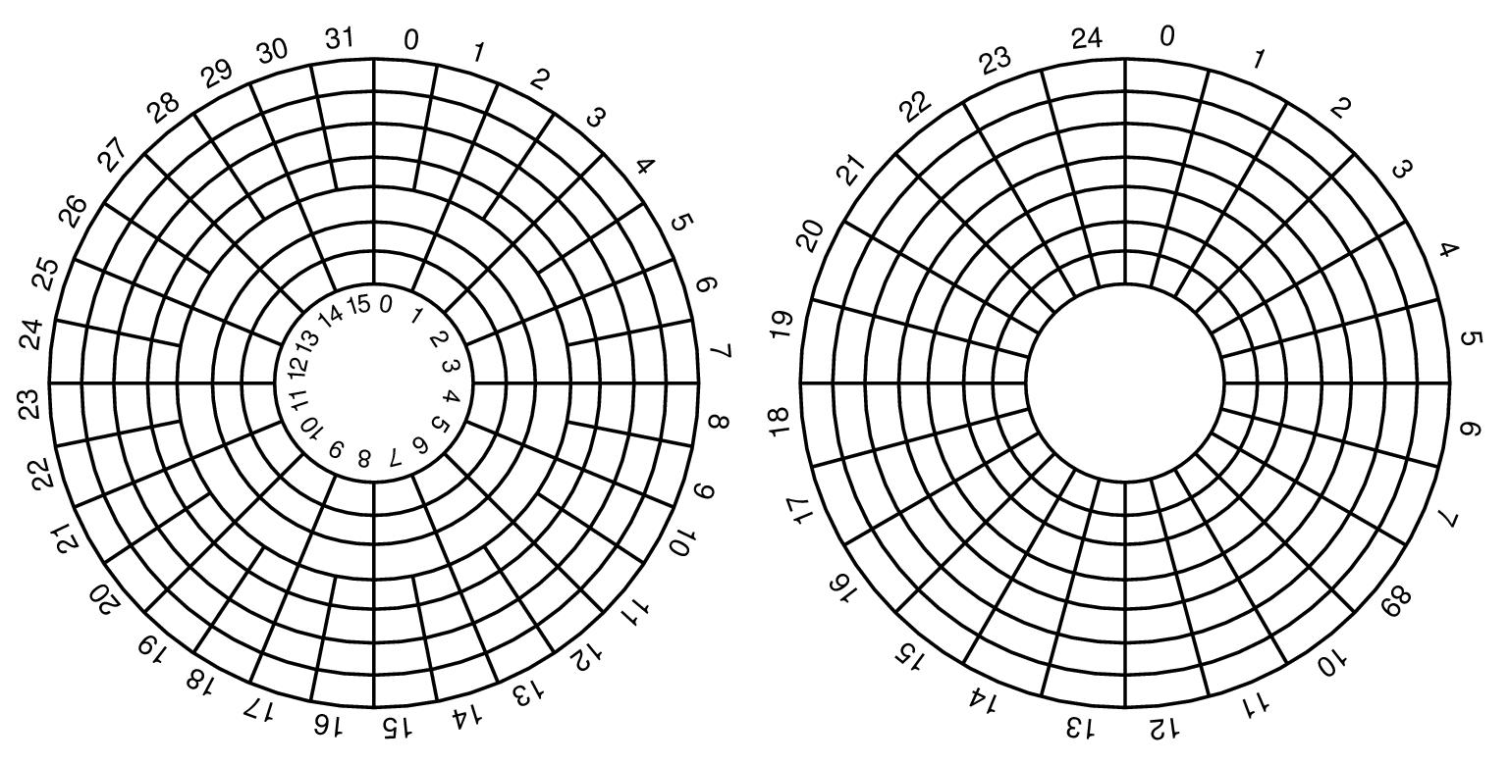
Disk zones
Constant rotation speed
  Want constant bit density
Inner tracks:
  Fewer sectors per track
Outer tracks:
  More sectors per track

Slide 6
Disk geometry
Physical Geometry
  The actual layout of sectors on the disk may be complicated
  The disk controller does the translation
  The CPU sees a “virtual geometry”.

Slide 7
Disk geometry
physical geometry
virtual geometry
(192 sectors in each view)

Slide 8
Disk formatting
A disk sector
Typically
  512 bytes / sector
  ECC = 16 bytes

Slide 9
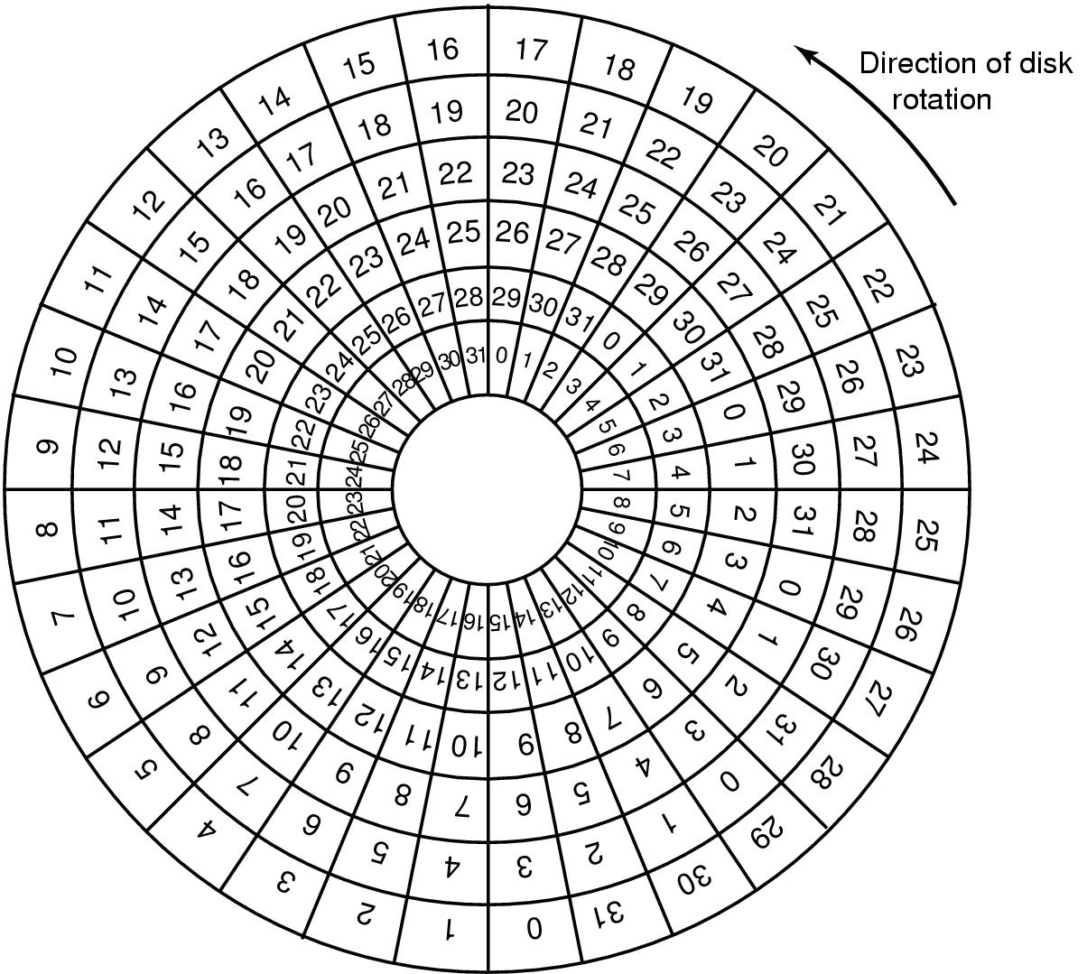
Cylinder skew

Slide 10
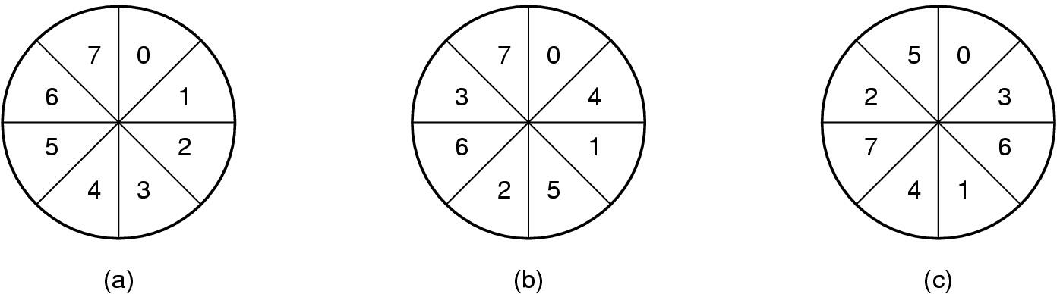
Sector interleaving
No
Interleaving
Single
Interleaving
Double
Interleaving

Slide 11
Disk scheduling algorithms
Time required to read or write a disk block determined by 3 factors
  Seek time
  Rotational delay
  Actual transfer time
Seek time dominates
  Schedule disk heads to
  minimize it

Slide 12
Disk scheduling algorithms
First-come first serve
Shortest seek time first
Scan → back and forth to ends of disk
C-Scan → only one direction
Look → back and forth to last request
C-Look → only one direction

Slide 13
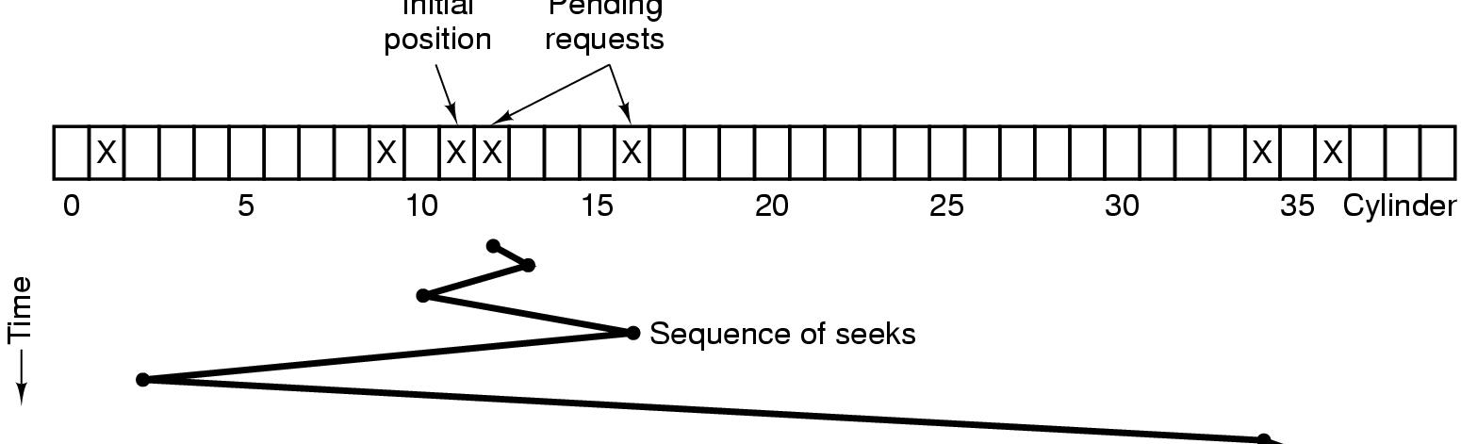
Shortest seek first (SSF)
Initial
position
Pending
requests

Slide 14
Shortest seek first (SSF)
Cuts arm motion in half
Fatal problem:
  Starvation is possible!

Slide 15
The elevator algorithm
Use one bit to track which direction the arm is moving
  Up
  Down
Keep moving in that direction
Service the next pending request in that direction
When there are no more requests in the current direction, reverse direction

Slide 16
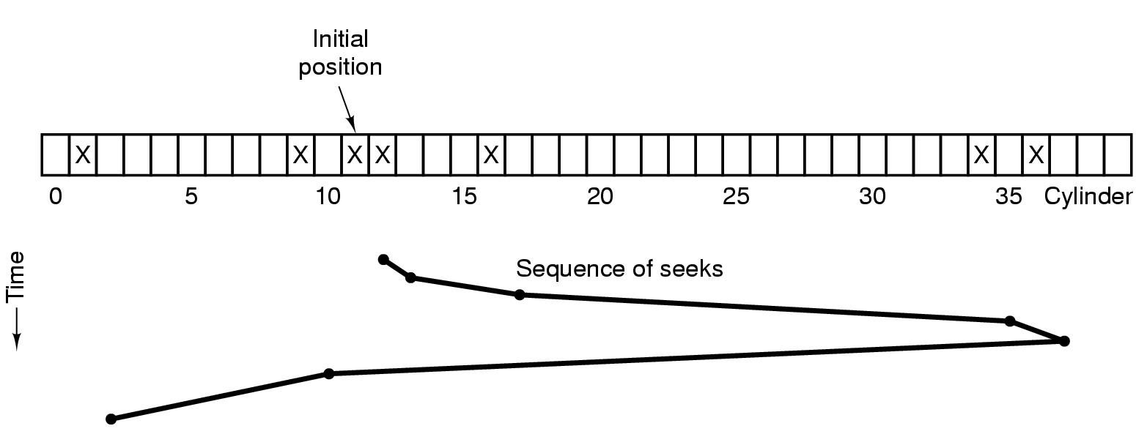
The elevator algorithm

Slide 17
Other disk scheduling algorithms
First-come first serve
Shortest seek time first
Scan → back and forth to ends of disk
C-Scan → only one direction
Look → back and forth to last request
C-Look → only one direction

Slide 18
Errors on disks
Transient errors v. hard errors
Manufacturing defects are unavoidable
  Some will be masked with the ECC (error correcting code) in each sector
Dealing with bad sectors
  Allocate several spare sectors per track
At the factory, some sectors are remapped to spares
  Errors may also occur during the disk lifetime
The sector must be remapped to a spare
  By the OS
  By the device controller

Slide 19
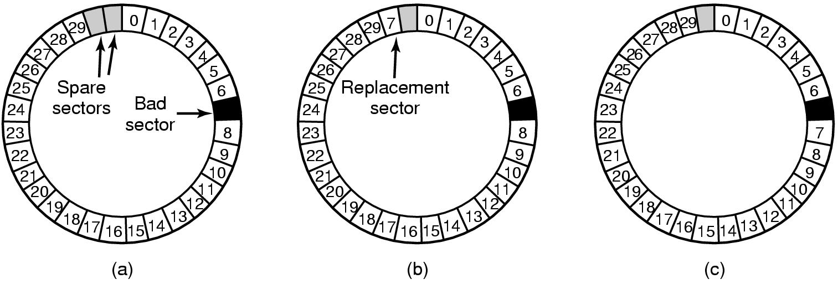
Using spare sectors
Substituting
a new sector
Shifting
sectors

Slide 20
Handling bad sectors in the OS
Add all bad sectors to a special file
  The file is hidden; not in the file system
  Users will never see the bad sectors
    There is never an attempt to access the file
Backups
  Some backup programs copy entire tracks at a time
    Efficient
  Problem:
    May try to copy every sector
    Must be aware of bad sectors

Slide 21
Stable storage
The model of possible errors:
  Disk writes a block and reads it back for confirmation
  If there is an error during a write...
    It will probably be detected upon reading the block
  Disk blocks can go bad spontaneously
    But subsequent reads will detect the error
  CPU can fail (just stops)
    Disk writes in progress are detectable errors
  Highly unlikely to loose the same block on two disks (on the same day)

Slide 22
Stable storage
Use two disks for redundancy
Each write is done twice
  Each disk has N blocks.
  Each disk contains exactly the same data.
To read the data ...
  you can read from either disk
To perform a write ...
  you must update the same block on both disks
If one disk goes bad ...
  You can recover from the other disk

Slide 23
Stable storage
Stable write
  Write block on disk # 1
  Read back to verify
  If problems...
    Try again several times to get the block written
    Then declare the sector bad and remap the sector
    Repeat until the write to disk #1 succeeds
  Write same data to corresponding block on disk #2
    Read back to verify
    Retry until it also succeeds

Slide 24
Stable storage
Stable Read
  Read the block from disk # 1
  If problems...
    Try again several times to get the block
  If the block can not be read from disk #1...
    Read the corresponding block from disk #2
  Our Assumption:
    The same block will not simultaneously go bad on both disks

Slide 25
Stable storage
Crash Recovery
Scan both disks
Compare corresponding blocks
For each pair of blocks...
  If both are good and have same data...
    Do nothing; go on to next pair of blocks
  If one is bad (failed ECC)...
    Copy the block from the good disk
  If both are good, but contain different data...
    (CPU must have crashed during a “Stable Write”)
    Copy the data from disk #1 to disk #2

Slide 26
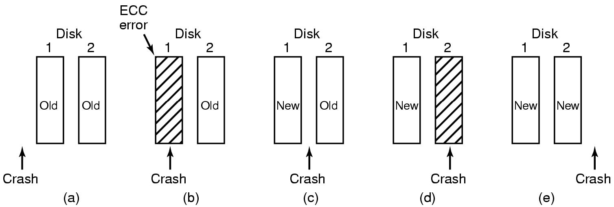
Crashes during a stable write

Slide 27
Stable storage
Disk blocks can spontaneously decay
Given enough time...
  The same block on both disks may go bad
    Data could be lost!
  Must scan both disks to watch for bad blocks (e.g., every day)
Many variants to improve performance
  Goal: avoid scanning entire disk after a crash.
  Goal: improve performance
    Every stable write requires: 2 writes & 2 reads
    Can do better...

Slide 28
RAID
Redundant Array of Independent Disks
Redundant Array of Inexpensive Disks
Goals:
  Increased reliability
  Increased performance

Slide 29
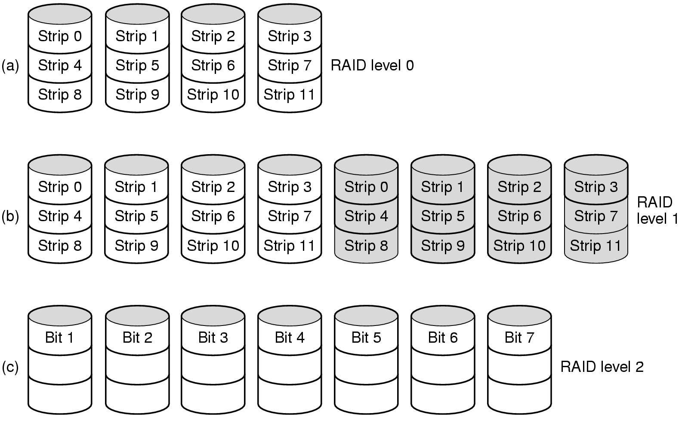
RAID

Slide 30
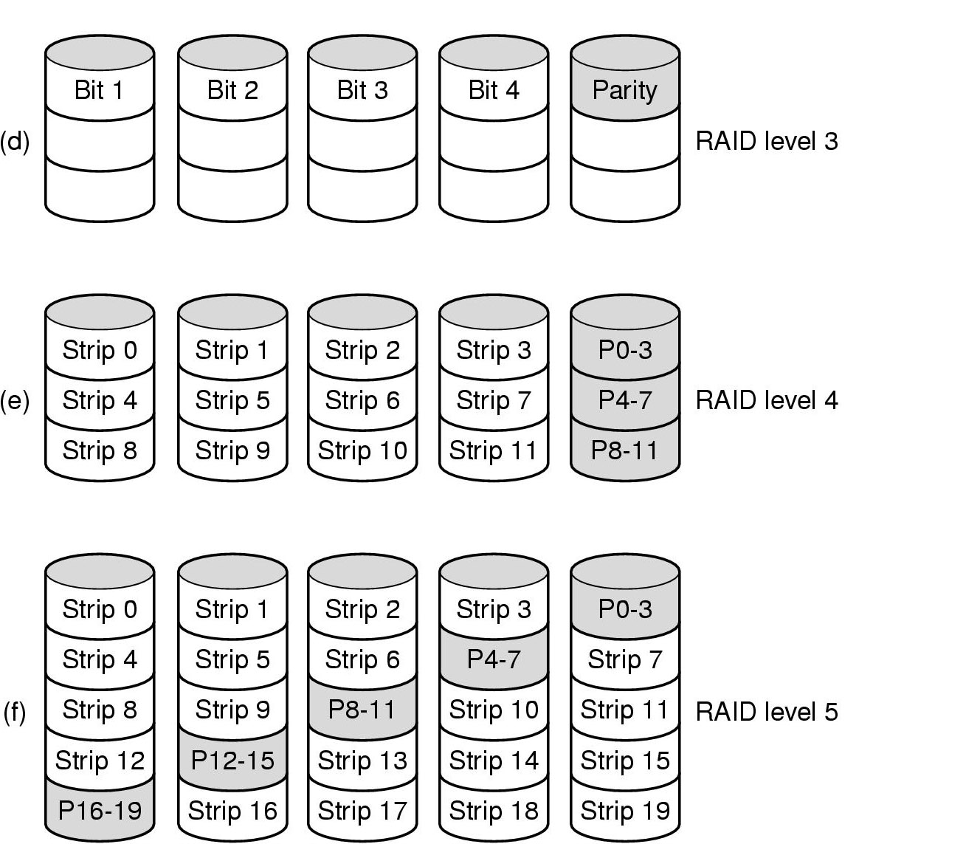
RAID

Slide 31
Disk space management
The OS must choose a disk “block” size...
  The amount of data written to/from a disk
  Must be some multiple of the disk’s sector size
How big should a disk block be?
  = Page Size?
  = Sector Size?
  = Track size?

Slide 32
Disk space management
How big should a disk block be?
  = Page Size?
  = Sector Size?
  = Track size?
Large block sizes:
  Internal fragmentation
  Last block has (on average) 1/2 wasted space
  Lots of very small files; waste is greater.

Slide 33
Disk space management
Must choose a disk block size...
  = Page Size?
  = Sector Size?
  = Track size?
Large block sizes:
  Internal fragmentation
  Last block has (on average) 1/2 wasted space
  Lots of very small files; waste is greater.
Small block sizes:
  More seeks; file access will be slower.

Slide 34
Block size tradeoff
Smaller block size?
  Better disk utilization
  Poor performance
Larger block size?
  Lower disk space utilization
  Better performance

Slide 35
Example
A Unix System
  1000 users, 1M files
  Median file size = 1,680 bytes
  Mean file size = 10,845 bytes
  Many small files, a few really large files

Slide 36
Example
A Unix System
  1000 users, 1M files
  Median file size = 1,680 bytes
  Mean file size = 10,845 bytes
  Many small files, a few really large files
Let’s assume all files are 2 KB...
  What happens with different block sizes?
  (The tradeoff will depend on details of disk performance.)

Slide 37
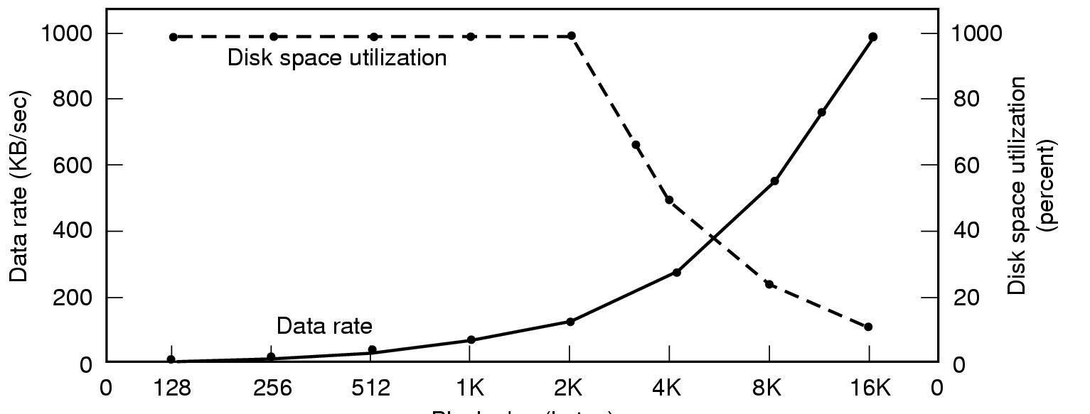
Block size tradeoff
sd
Block size
Assumption: All files are 2K bytes
Given: Physical disk properties
Seek time=10 msec
Transfer rate=15 Mbytes/sec
Rotational Delay=8.33 msec * 1/2

Slide 38
Managing free blocks
Approach #1:
  Keep a bitmap
  1 bit per disk block
Approach #2
  Keep a free list

Slide 39
Managing free blocks
Approach #1:
  Keep a bitmap
  1 bit per disk block
    Example:
      1 KB block size
      16 GB Disk ⇒ 16M blocks = 2²⁴ blocks
    Bitmap size = 2²⁴ bits ⇒ 2K blocks
      1/8192 space lost to bitmap
Approach #2
  Keep a free list

Slide 40
Free list of disk blocks
Linked List of Free Blocks
Each block on disk holds
  A bunch of addresses of free blocks
  Address of next block in the list
null

Slide 41
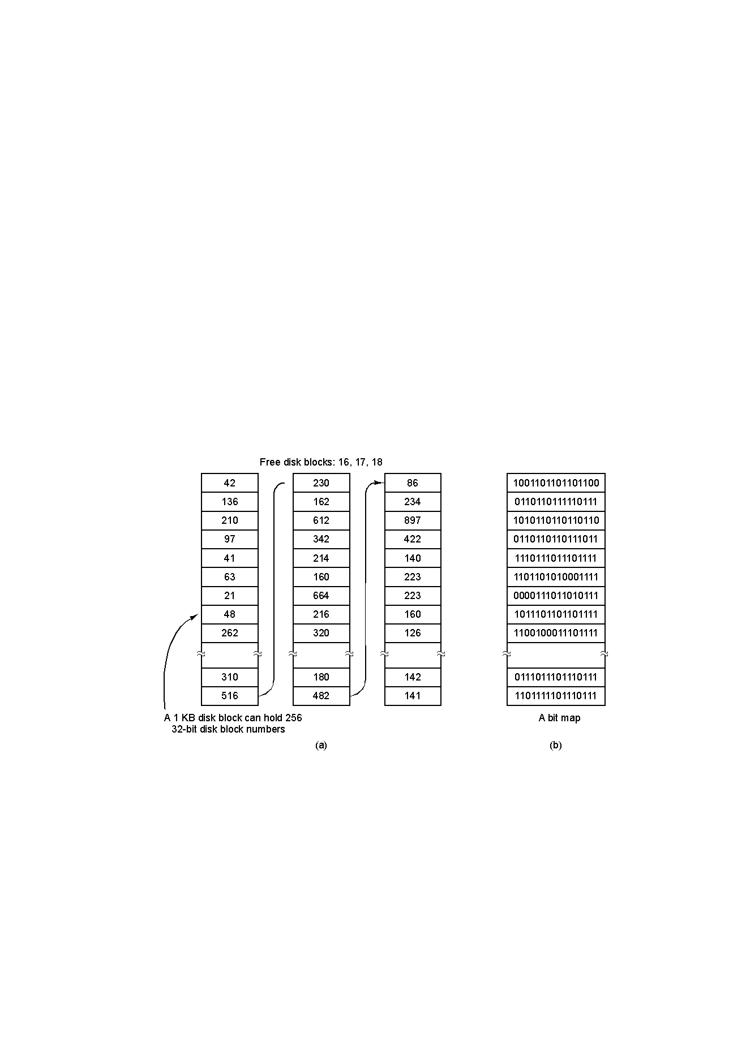
Free list of disk blocks
asd
Assumptions:
Block size = 1K
Each block addr = 4bytes
Each block holds
255 ptrs to free blocks
1 ptr to the next block
This approach takes more space than bitmap...
But “free” blocks are used, so no real loss!

Slide 42
Free list of disk blocks
Two kinds of blocks:
  Free Blocks
  Block containing pointers to free blocks
Always keep one block of pointers in memory.
This block may be partially full.
Need a free block?
  This block gives access to 255 free blocks.
  Need more?
    Look at the block’s “next” pointer
    Use the pointer block itself
    Read in the next block of pointers into memory

Slide 43
Free list of disk blocks
To return a block (X) to the free list...
  If the block of pointers (in memory) is not full:
    Add X to it

Slide 44
Free list of disk blocks
To return a block (X) to the free list…
  If the block of pointers (in memory) is not full:
    Add X to it
  If the block of pointers (in memory) is full:
    Write it to out to the disk
    Start a new block in memory
    Use block X itself for a pointer block
      All empty pointers
      Except the next pointer

Slide 45
Free list of disk blocks
Scenario:
  Assume the block of pointers in memory is almost empty.
  A few free blocks are needed.

Slide 46
Free list of disk blocks
Scenario:
  Assume the block of pointers in memory is almost empty.
  A few free blocks are needed.
    This triggers disk read to get next pointer block
  Now the block in memory is almost full.

Slide 47
Free list of disk blocks
Scenario:
  Assume the block of pointers in memory is almost empty.
  A few free blocks are needed.
    This triggers disk read to get next pointer block
  Now the block in memory is almost full.
  Next, a few blocks are freed.

Slide 48
Free list of disk blocks
Scenario:
  Assume the block of pointers in memory is almost empty.
  A few free blocks are needed.
    This triggers disk read to get next pointer block
  Now the block in memory is almost full.
  Next, a few blocks are freed.
  The block fills up
    This triggers a disk write of the block of pointers.

Slide 49
Free list of disk blocks
Scenario:
  Assume the block of pointers in memory is almost empty.
  A few free blocks are needed.
    This triggers disk read to get next pointer block
  Now the block in memory is almost full.
  Next, a few blocks are freed.
  The block fills up
    This triggers a disk write of the block of pointers.
Problem:
  Numerous small allocates and frees, when block of pointers is right at boundary
  Lots of disk I/O associated with free block mgmt!

Slide 50
Free list of disk blocks
Solution (in text):
  Try to keep the block in memory about 1/2 full
  When the block in memory fills up...
    Break it into 2 blocks (each 1/2 full)
    Write one out to disk
Similar Algorithm:
  Keep 2 blocks of pointers in memory at all times.
  When both fill up
    Write out one.
  When both become empty
  Read in one new block of pointers.

Slide 51
Comparison: free list vs bitmap
Desirable:
  Keep all the blocks in one file close together.

Slide 52
Comparison: free list vs bitmap
Desirable:
  Keep all the blocks in one file close together.
Free Lists:
  Free blocks are all over the disk.
  Allocation comes from (almost) random location.

Slide 53
Comparison: free list v. bitmap
Desirable:
  Keep all the blocks in one file close together.
Free Lists:
  Free blocks are all over the disk.
  Allocation comes from (almost) random location.
Bitmap:
  Much easier to find a free block “close to” a given position
  Bitmap implementation:
    Keep 2 MByte bitmap in memory
    Keep only one block of bitmap in memory at a time

Slide 54
Spare slides

Slide 55
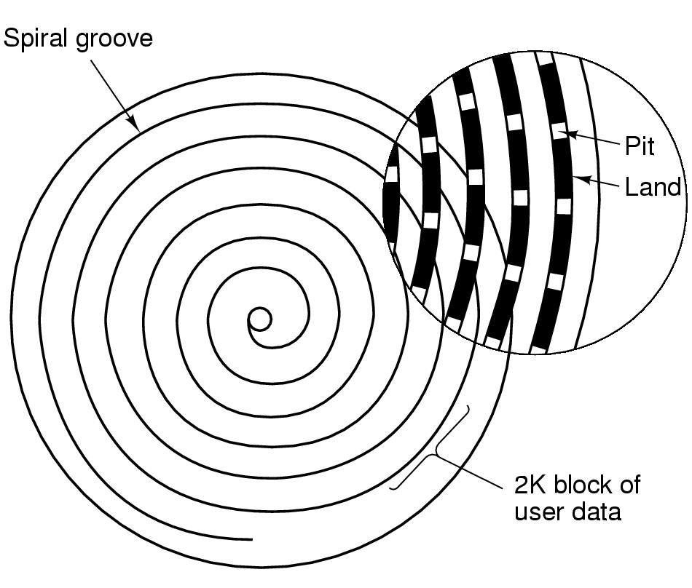
CDs & CD-ROMs

Slide 56
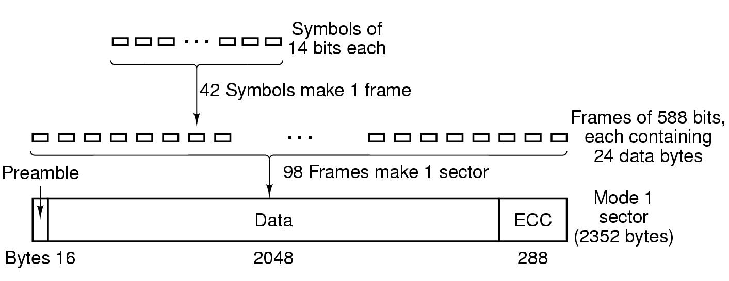
CD-ROMs
32x CD-ROM = 5,000,000 Bytes/Sec
SCSI-2 is twice as fast.

Slide 57
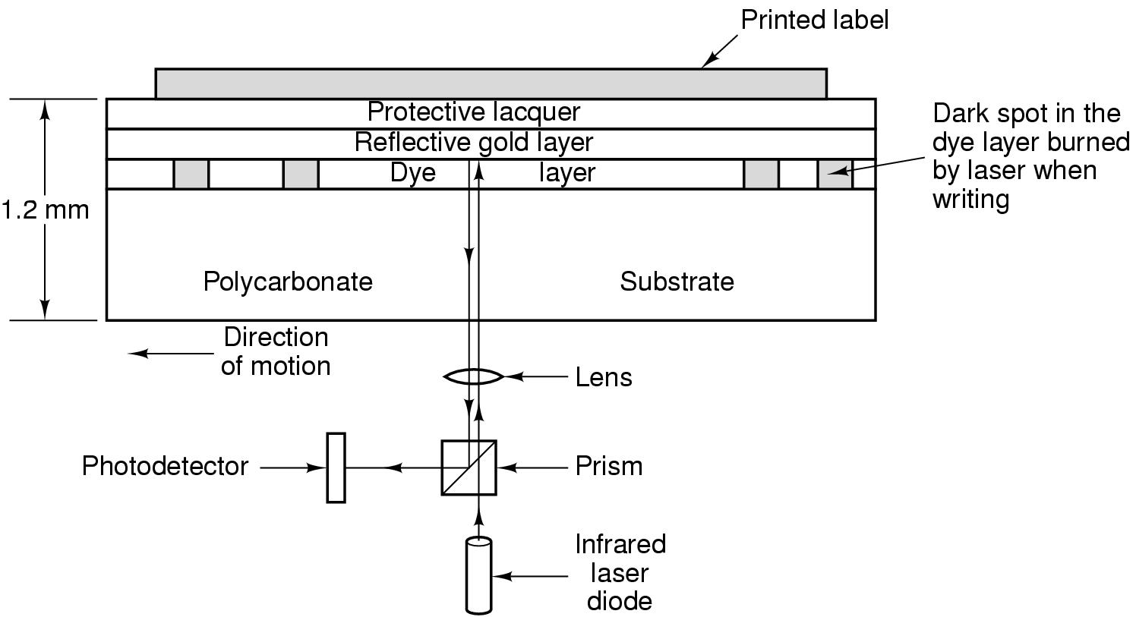
CD-R (CD-Recordable)

Slide 58
Updating write-once media
VTOC = Volume Table of Contents
When writing, an entire track is written at once
Each track has its own VTOC

Slide 59
Updating write-once media
VTOC = Volume Table of Contents
When writing, an entire track is written at once.
Each track has its own VTOC.
Upon inserting a CD-R,
  Find the last track
  Obtain the most recent VTOC
    This can refer to data in earlier tracks
  This tells which files are on the disk
  Each VTOC supercedes the previous VTOC

Slide 60
Updating write-once media
VTOC = Volume Table of Contents
When writing, an entire track is written at once.
Each track has its own VTOC.
Upon inserting a CD-R,
  Find the last track
  Obtain the most recent VTOC
    This can refer to data in earlier tracks
  This tells which files are on the disk
  Each VTOC supercedes the previous VTOC
Deleting files?

Slide 61
CD-RW
Uses a special alloy
Alloy has two states, with different reflectivities
  Crystalline (highly reflective) - Looks like “land”
  Amorphous (low reflectivity) - Looks like a “pit”
Laser has 3 powers
  Low power: Sense the state without changing it
  High power: Change to amorphous state
  Medium power: Change to crystalline state

Slide 62
DVDs
“Digital Versatile Disk”
  Smaller Pits
  Tighter Spiral
  Laser with different frequency
Transfer speed
  1X = 1.4MB/sec (about 10 times faster than CD)
Capacity
  4.7 GB Single-sided, single-layer (7 times a CD-ROM)
  8.5 GB Single-sided, double-layer
  9.4 GB Double-sided, single-layer
  17 GB Double-sided, double-layer

Slide 63
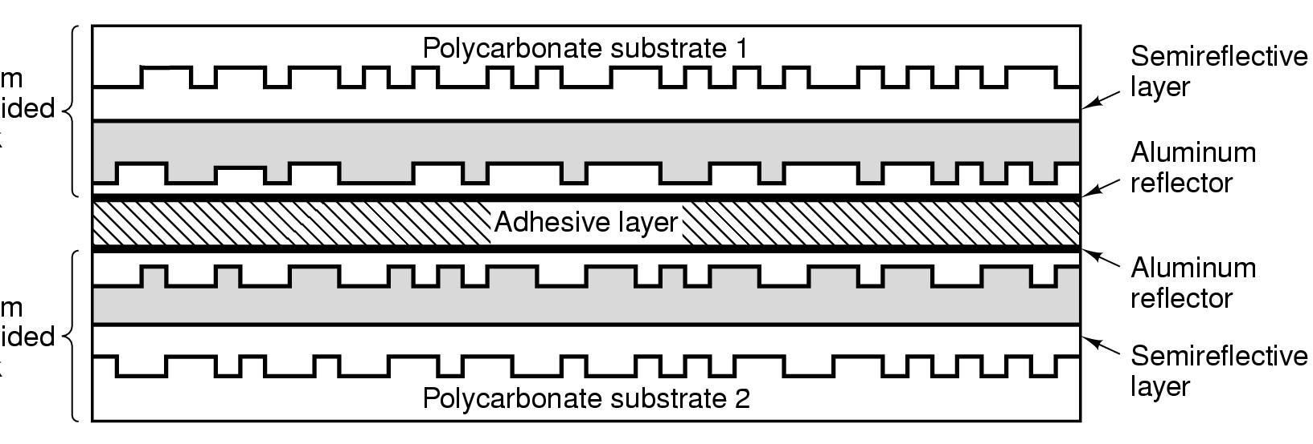
DVDs
0.6mm
Single-sided
disk
0.6mm
Single-sided
disk

